Slide 1
A Practical Approach to Timeseries Forecasting using Python
Overview of the Section
Revision for Data Preparation
Applied Machine Learning in Time Series
Shahzaib Hamid

Slide 2
Overview of the Section
In this section
Impact and Overview of Machine Learning on Time Series Forecasting
Univariate Time Series Forecasting
Autoregression (AR)
Moving Average (MA)
Autoregressive Moving Average (ARMA)
Autoregressive integrated moving average (ARIMA)
Auto ARIMA
Seasonal Autoregressive Integrated Moving-Average (SARIMA)
Auto - SARIMA in Time Series Forecasting

Slide 3
Revision for Data Preparation
Basic Data Analysis and Visualization for Time Series
Data Manipulation and Preprocessing
Feature Engineering and RVT in Time Series
Stationary Check
Making a Non-Stationary Data Stationary

Slide 4
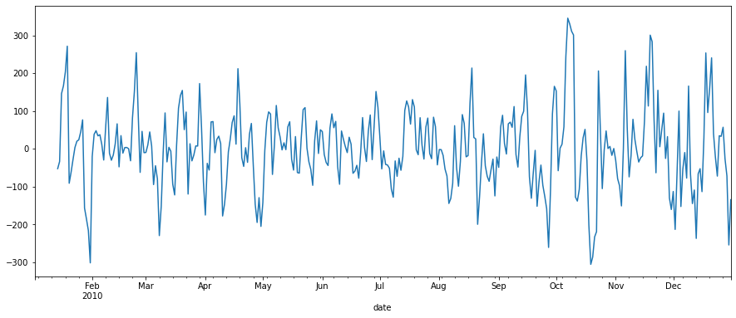
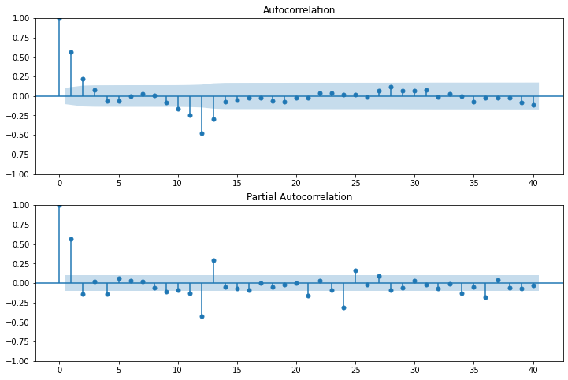
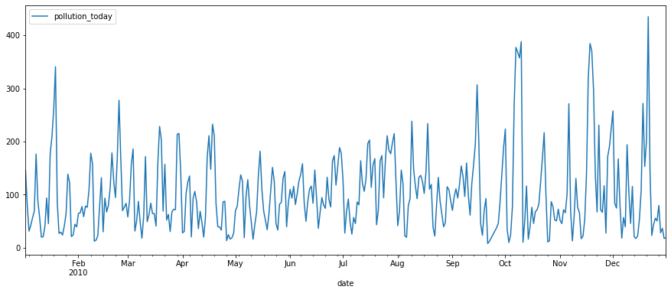
Auto Correlation and Partial Correlation

Slide 5
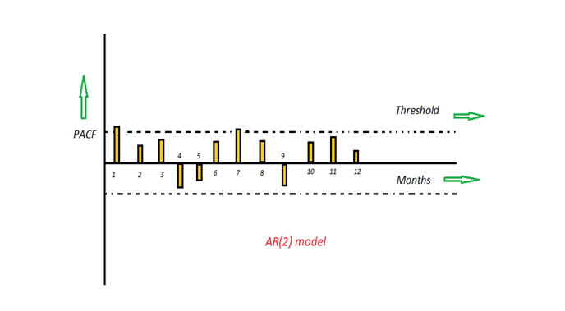
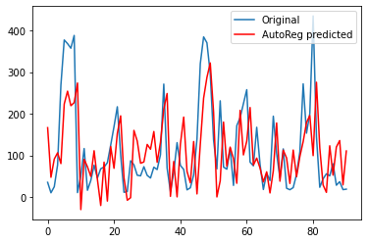
Autoregression (AR)
The term AR stands for autoregression.
The number of preceding inputs used to predict the next value is called order and is usually referred to as p
The time period at t is impacted by the observation at various slots t-1, t-2, t-3, ….., t-k.

Slide 6
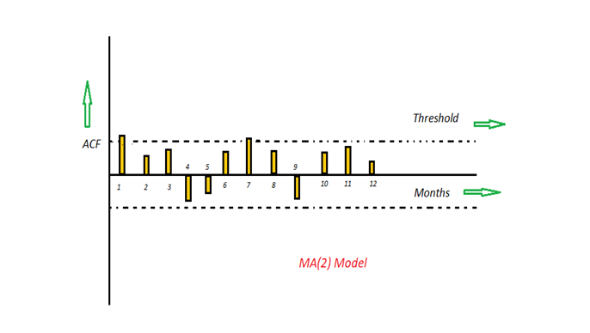
Moving average (MA)
Number of MA (Moving Average) terms (q)
Example: Cake Distribution

Slide 7
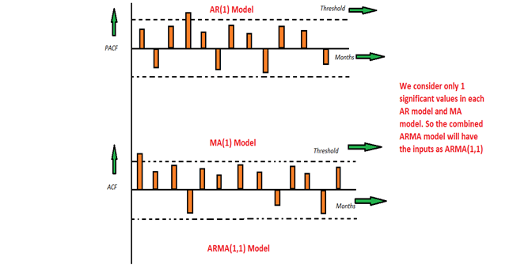
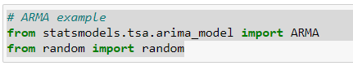
Autoregressive Moving Average (ARMA)
This is a model that is combined from the AR and MA models.
The impact of previous lags along with the residuals is considered for forecasting the future values of the time series.

Slide 8
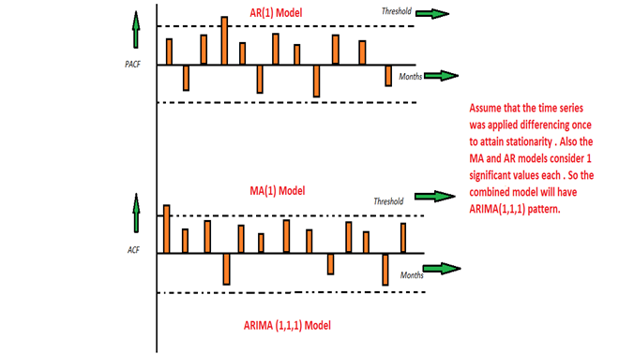
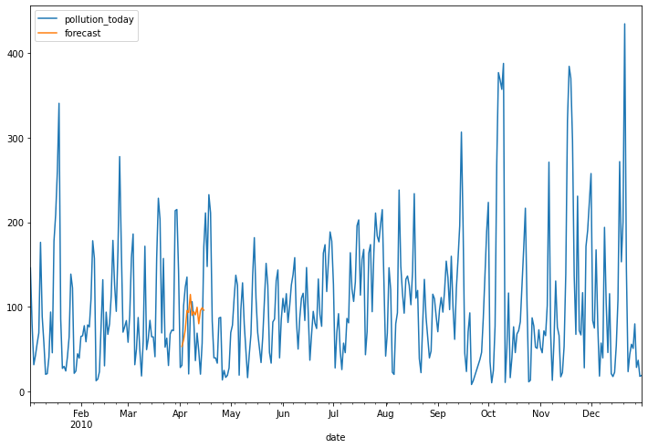
Auto-Regressive Integrated Moving Average (ARIMA) Model
The ARIMA model is quite similar to the ARMA model other than the fact that it includes one more factor known as Integrated( I )
In an ARIMA model there are 3 parameters that are used to help model the major aspects of a times series: seasonality, trend, and noise. These parameters are labeled p,d,and q.

Slide 9
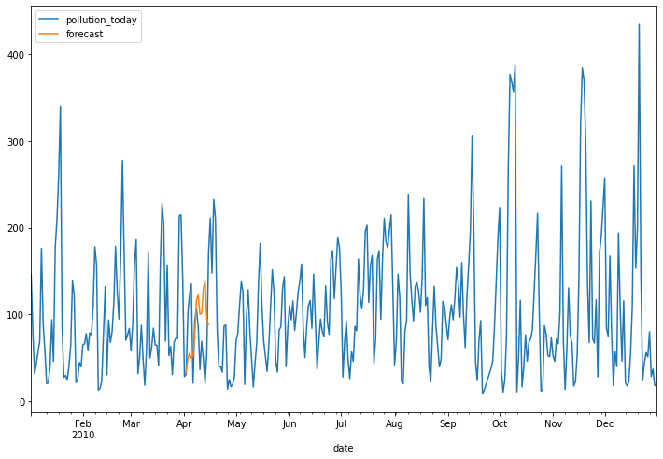
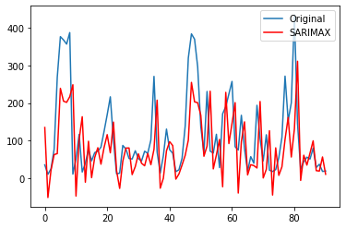
Seasonal Autoregressive Integrated Moving-Average (SARIMA)
There are three trend elements that require configuration. They are the same as the ARIMA model, specifically:
p: Trend autoregression order.
d: Trend difference order.
q: Trend moving average order
There are four seasonal elements that are not part of ARIMA that must be configured; they are:
P: Seasonal autoregressive order.
D: Seasonal difference order.
Q: Seasonal moving average order.
m: The number of time steps for a single seasonal period. For example, an S of 12 for monthly data suggests a yearly seasonal cycle.

